Slide 2
Power of AI in Power Platform
Keval Solanki
Prasham Sabadra

Slide 3



Keval Solanki
Works @ Tieto India Private Limited, Pune as Software Architect
A SharePoint Enthusiast, Office 365 Migration Specialist!
Worked on different SharePoint versions from earlier days of SharePoint.
Enabling different customers to help to adopt and best use O365.
MCP, MCTS in SharePoint, .Net, Office 365.
Speaker at various conferences.
Keval.Solanki@tieto.com
Linkedin
@keval_solanki

Slide 4

Prasham Sabadra
Works @ Tieto India Private Limited, Pune as Software Architect
Since last 14 years working on SharePoint starting with SharePoint 2003 till now with Office 365
MCP, MCTS [WSS 3.0, MOSS, SharePoint 2010, HTML5, SharePoint 2013, Office 365]
Conference speaker (SharePoint, Office 365) , Motivational speaker, Spoke in SPS 2018 India in Noida, 2019 in SPS Pune and in SPS Sweden
Blogger at knowledge-junction.com
IT-geek, community-guy, reading-addicted and continuous 5 time c-sharpcorner.com MVP in a row.
psabadra@gmail.com
LinkedIn
@sabadraprasham

Slide 5
Feedback Processing using Text Classification Model

Slide 6
Feedback Processing using Text Classification Model
Feedback from Portal
CDS
Feedback in SharePoint List
Email to concerned department if feedback needs attention
Text classification AI Model
Feedback Processing Flow

Slide 7
Introduction to AI Builder in Power platform

Slide 8
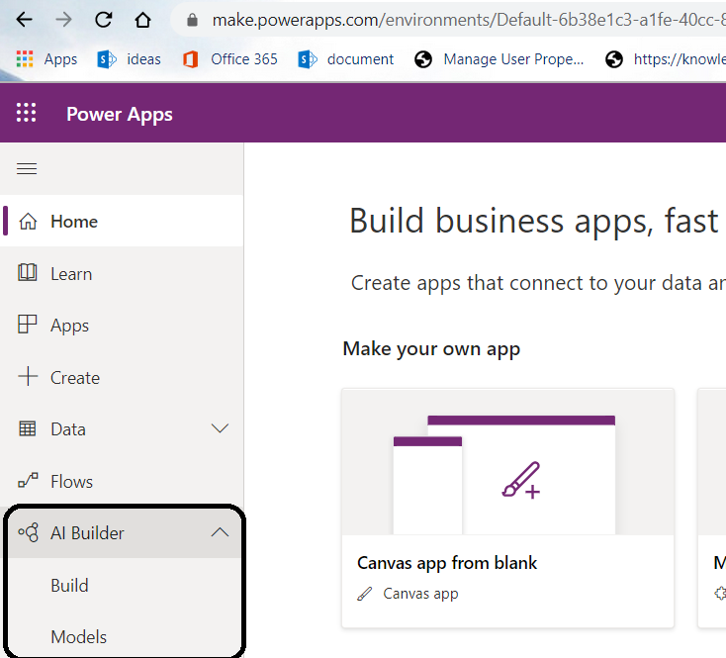
AI Builder
New Artificial Intelligence feature in Power Platform.
Allows us to easily automate processes and predict outcomes to help improve business process.
No special coding or data-science skills required.
AI Builder features are available as per regions. Region in which your environment is hosted.
For feature availability as per region, please have a look once - https://docs.microsoft.com/en-us/ai-builder/availability-region
In AI Builder, AI is based on Model Types.
What’s Coming?
General Availability October 2019 through March 2020
Extend AI Builder to Dynamics 365 and grow up to Pro AI
Support for additional AI scenarios

Slide 9
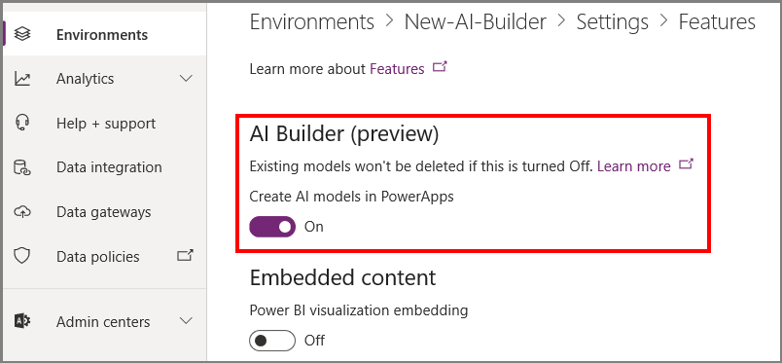
Enable or disable AI Builder feature
Power Platform administrators can use the Power Platform Admin center to control the availability of AI Builder in an environment.
Following are the steps:
Sign in to Power Platform Admin center
Environments >> Our Environment >>
Settings >> Features >> AI Builder(preview)

Slide 10

Time to grab a Goodie
What Is Microsoft Power Platform?
Answer:

Slide 11
Model Types

Slide 12
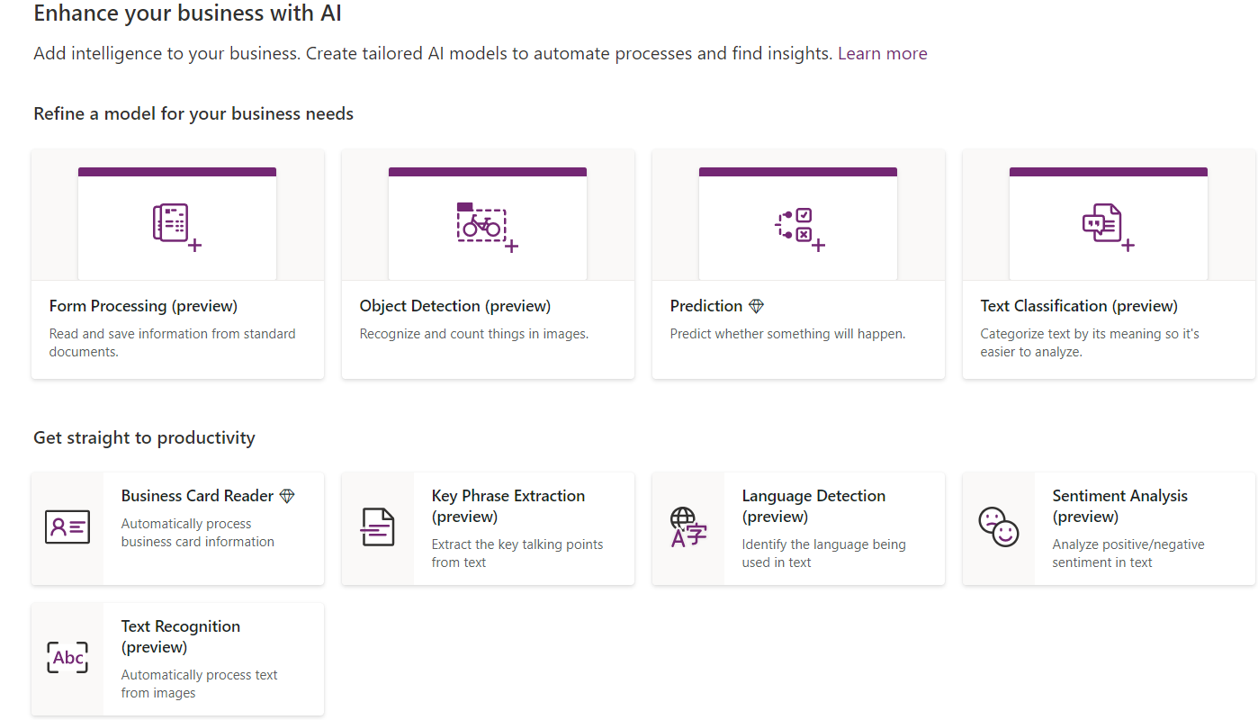
Model Types

Slide 13
There are certain predefined features available which MS provides.
Prebuilt AI Models –
Models which we can build by choosing a model type in AI builder, train ourself for our specific tasks
Prediction
Form Processing (Preview)
Object detection (Preview)
Text classification (Preview)
Custom AI Models –
These are the pre build feature which we can directly use in Power Apps or Power Automate
These models are built by Microsoft and trained for doing specific task
Business Card Reader
Key phrase extraction (Preview)
Language detection (Preview)
Text recognition (Preview)

Slide 14
How to build and train

Slide 15
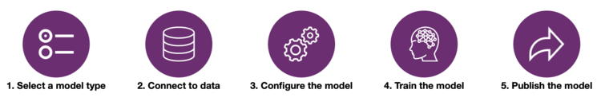

Slide 17
Time to grab a Goodie
What is CDS? What's it use?
Answer:

Slide 18
References

Slide 19
What's new and planned for AI Builder -
https://docs.microsoft.com/en-us/power-platform-release-plan/2019wave2/ai-builder/planned-features
Power Platform Admin - https://admin.powerplatform.microsoft.com/
Feature availability by region - https://docs.microsoft.com/en-us/ai-builder/availability-region
What is AI Builder? - https://docs.microsoft.com/en-us/ai-builder/overview
Use AI Builder in Power Apps - https://docs.microsoft.com/en-us/powerapps/use-ai-builder

